Slide 1
SISTEMAS OPERATIVOS
SO
E – M 2019

Slide 2
Processes
Process Concept

Slide 3
Process Concept
Process – a program in execution; process execution must progress in sequential fashion
An operating system executes a variety of programs:
System Programs – processes
Batch system – jobs
Time-shared systems – user programs or tasks
Textbook uses the terms job, task and process almost interchangeably

Slide 4
Process Management
A process requires services as creating, running, terminating, suspending and resuming.
A process requires resources as memory, storage, CPU time, etc., provided by the Memory Management, Storage Management, Scheduling, respectively.

Slide 5
A running process’ address space
PID = ####
0xFFFFFFFF
OS resources
(open files, network connect.,
Sound channels, …)
CPU
General Registers
stack
(storage call returns, etc.)
SP
Memory address space
heap
(dynamic allocated mem)
Code section
(text segment)
PC
static data section
(data segment)
0x00000000

Slide 6
What is in and around a Process?
Process parts
a memory address space
the code (text) section for the running program
the (static) data section for the running program
containing global variables
an execution stack and stack pointer (SP)
traces state of procedure calls made
function parameters, return addresses, local variables
the heap, for dynamic data allocation during run time
Function parameters, local variables, dynamic objects
a set of OS resources
open files, network connections, sound channels, …

Slide 7
What is in and around a Process?
Process parts (cont.)
the program counter (PC), indicating the next instruction
a set of general-purpose processor registers and their values
A Process IDentifier (PID), asigned by the Op Sys
A Process whole picture
Memory address space
The CPU and all its registers (values)

Slide 8
Processes
Process Scheduling
Done by Process Scheduler

Slide 9
Modelo inicial con 2 estados
Dispatch
Enter
Not
Running
Running
Exit
Pause
(a) Diagrama de transición de estados
Modelo simple de 2 estados de cada proceso (en memoria), con dos transiciones:
Not-Running --> Running; Running --> Not-Running.
¿Cuantos procesos puede haber en Not-Running ______ y Running ______ ?

Slide 10
Scheduler básico
Queue
Dispatch
Enter
CPU
Exit
Pause
(a) Dispatcher, Scheduler
Los procesos Not-Running están en ______ y él o los Running están ______.
Dispatcher – Scheduler o Planificador
Programa que asigna un proceso al CPU.
Previene de que un solo proceso monopolice el CPU en el caso del tiempo compartido (con el timer). Intercalado de procesos.

Slide 11
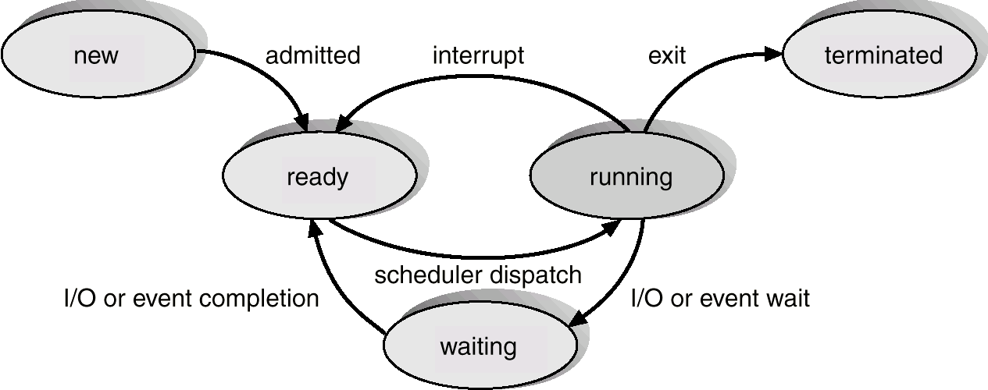
Diagram of Process State
[finished]
[timeout]
[blocked]

Slide 12
Los Estados de los Procesos
Cada proceso tiene un estado de ejecución que indica lo que le esta pasando
New: El proceso esta siendo creado, por diferentes administradores.
Ready: El proceso está en memoria, esperando a que se le asigne (tiempo de) CPU.
Running: sus instrucciones están siendo ejecutadas por el CPU.
Waiting o Blocked: El proceso espera a que su actividad iniciada con un dispositivo, ocurra; no hace nada mientras tanto.
Terminated, Finished o Exit: El proceso ha terminado su ejecución.

Slide 13
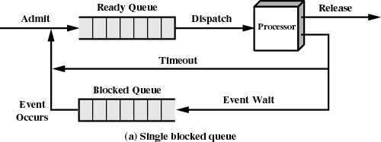
Queues structures
What is inside the queues?
The processes or what else?

Slide 14
Process data structures
How does the OS represent a process?
at any time, there are many processes, each in its own particular state
the OS data structure that represents each process is called the Process Control block (PCB)

Slide 15
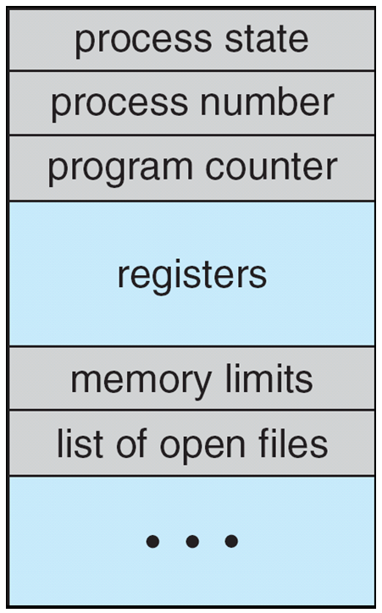
Process Control Block (PCB)
Information associated with each process
(also called task control block)
Process state – running, waiting, etc
Program counter – location of instruction to next execute
CPU registers – contents of all process-centric registers
CPU scheduling information- priorities, scheduling queue pointers
Memory-management information – memory allocated to the process
Accounting information – CPU used, clock time elapsed since start, time limits
I/O status information – I/O devices allocated to process, list of open files

Slide 16
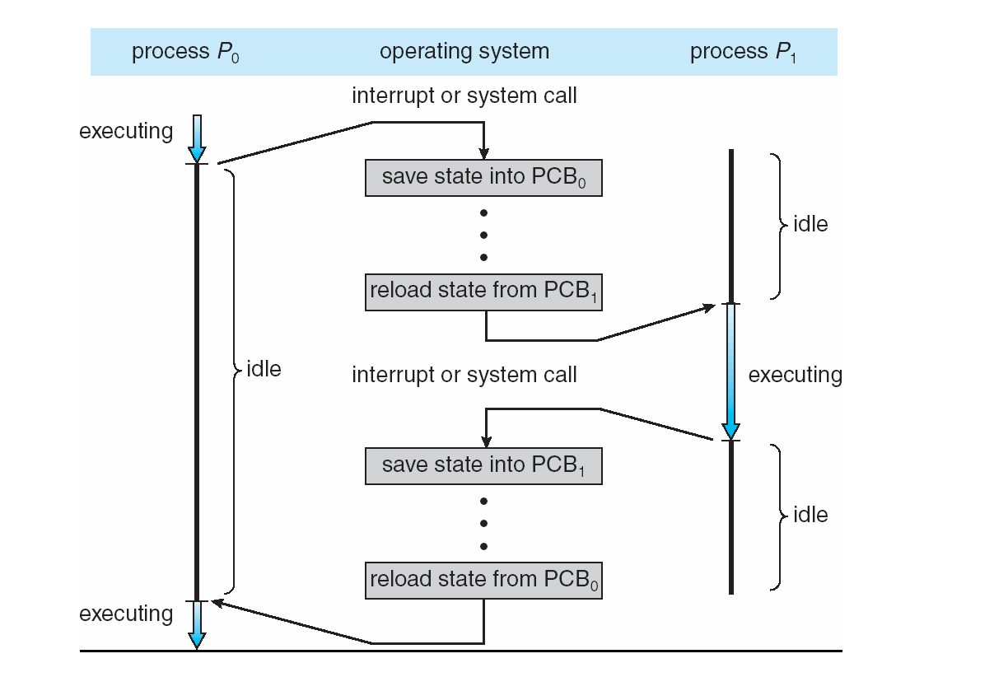
CPU Context Switch between Process

Slide 17
Cambio de Contexto del CPU
Es el acto de conmutar el CPU de un proceso a otro.
Cuando el CPU es conmutado hacia otro proceso, el SO debe guardar el estado del proceso saliente (e.g. el contenido actual de los registros en su respectivo PCB) y cargar el estado previamente guardado (de su respectivo PCB, e.g. el que tenían los registros en la anterior running) del nuevo proceso.
El Contexto de un proceso es representado por el PCB.
El cambio de contexto causa overhead; el sistema no hace trabajo útil durante la conmutación.
El tiempo entonces dependerá del hardware.

Slide 18
Process Scheduling
Maximize CPU use (____), quickly switch processes onto CPU for time sharing reducing the user waiting time
Process scheduler selects (from READY) among available processes for next execution on CPU (to RUNNING)
Maintains a set of scheduling queues of processes
Job Queue – set of all processes in the system
Ready Queue – set of all processes residing in main memory, READY to execute
Device Queues – set of processes WAITING for an I/O device
Processes migrate among the various queues using their PCBs
And where is the queue for RUNNING processes? _____

Slide 19
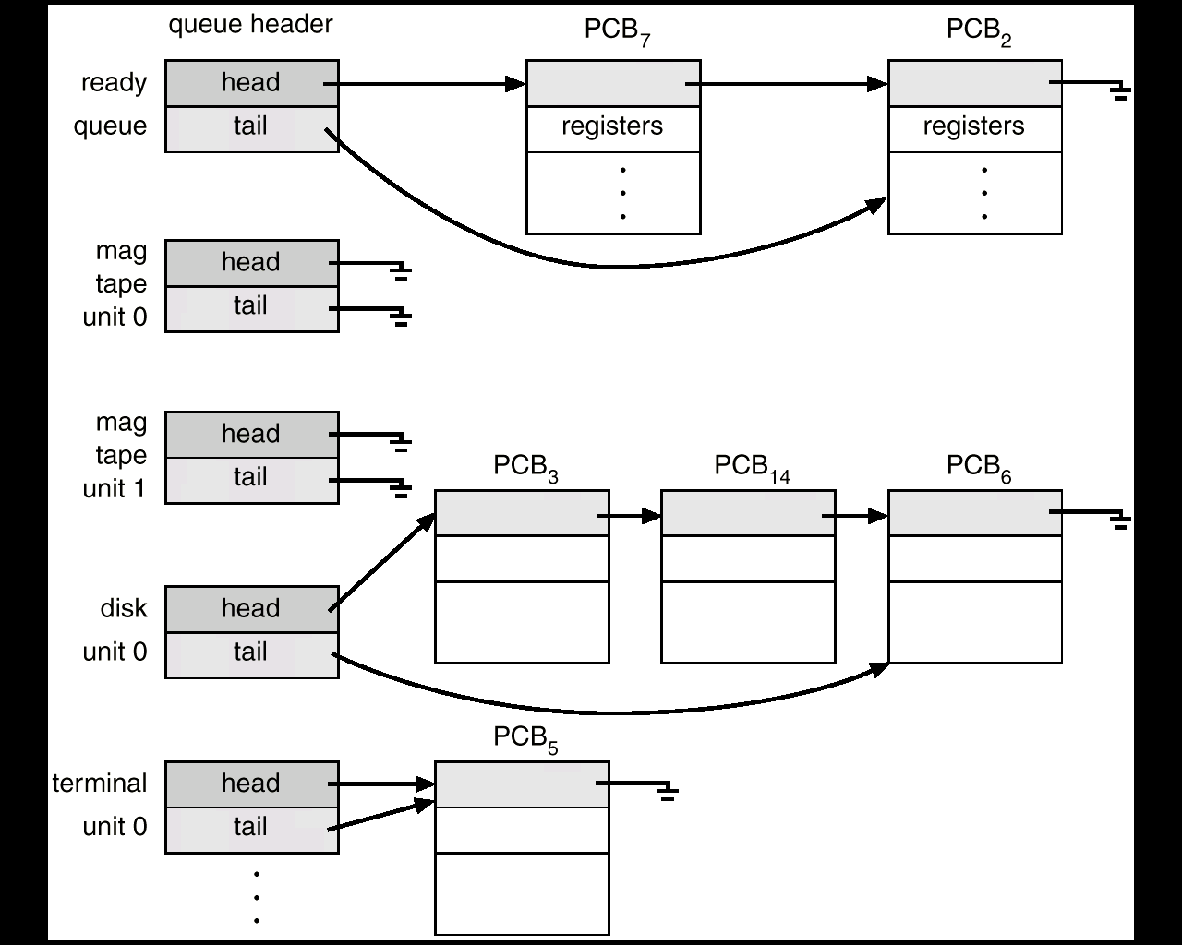
Queues: Ready and various IO Devices
Cola de Ready
Colas de Dispositivos

Slide 20
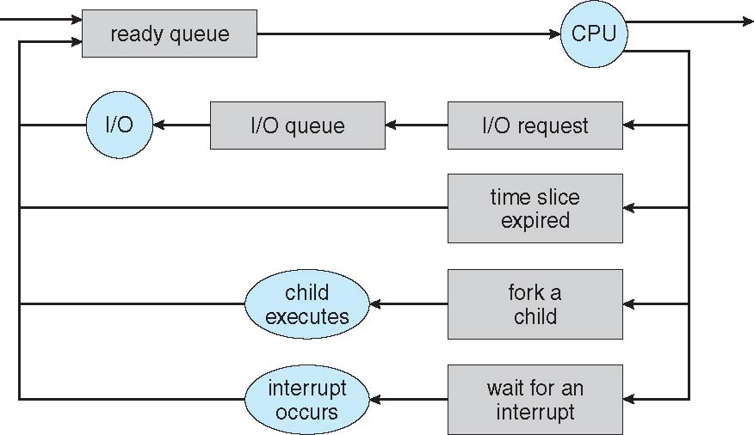
Representation of Process Scheduling
Queueing diagram represents queues, resources, flows

Slide 21
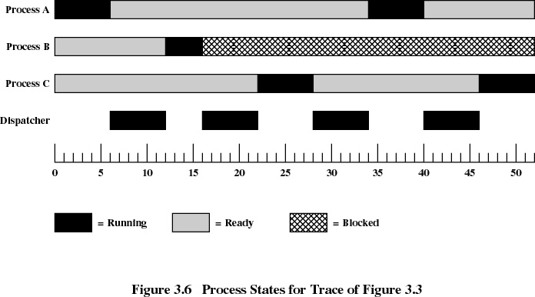
Ejemplo de 3 Procesos
or Scheduler

Slide 22
Process unit
The process is the OS’s abstraction for execution.
It is the unit of execution
It is the unit of scheduling

Slide 23
References
Presentación de Ramon Ríos.
Capítulos: Operating System Concepts; Silberschatz, Galvin, Gagne.
07-feb-2019

